Slide 1

CUSD nutritional services
we Don’t let hungry stomachs
Lead to distracted minds

Slide 2
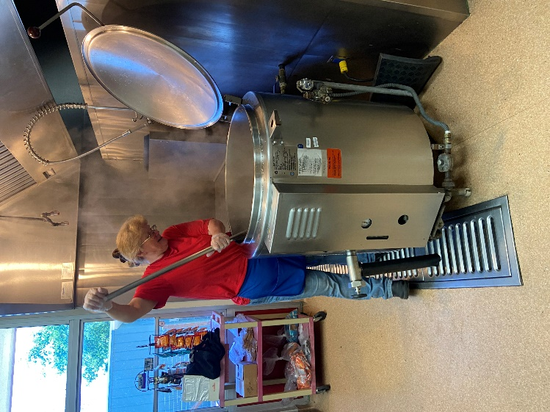
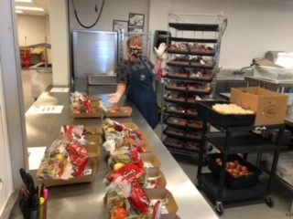
28 DEDICATED EMPLOYEES STRONG
Breakfast & Lunch is offered to every CUSD student at NO CHARGE every school day.
Thank you AB130 aka: “Universal Meals” https://www.cde.ca.gov/ls/nu/sn/cauniversalmeals.asp
California was the first state in the Nation to adopt free school meals as part of a child’s education. Many states have since followed the lead.

Slide 3
FUN FACTS & CELEBRATIONS
Total Reimbursable Breakfasts for the 22-23 SY: 157,797 or 877 average daily breakfasts
Total Reimbursable Lunches for the 22-23 SY: 307,258 or 1,707 average daily lunches
Not an easy feat to accomplish when battling late food deliveries, product unavailability and staffing shortages. This is why we celebrate National School Lunch Hero Day every year!

Slide 4

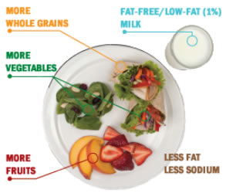
Reimbursable meal? What’s that?
A meal that MUST comply with USDA’s Federal Nutrition standards and CDE’s more stringent CNP guidelines.
We offer Five Star Meals in the right proportions with minimums and maximums of all the nutritionals:

Slide 5

MORE FUN FACTS
ABOUT WHY WE’RE AWESOME
Tufts University completed a 16 year study of nutrition in the United States. Their findings on Nutrition Security, sources of unhealthy and healthy food, looking at restaurants, entertainment venues, grocery stores and SCHOOLS.
THE RESULTS ARE IN! https://nutrition.tufts.edu/
SCHOOL MEALS ARE THE HEALTHIEST SOURCE OF FOOD IN THE UNITED STATES.
School Nutrition has proven to;
RAISE Test Scores, LOWER Behavior Problems and REDUCE Childhood Obesity.

Slide 6
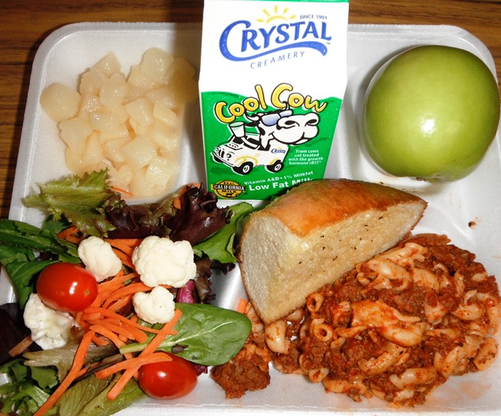
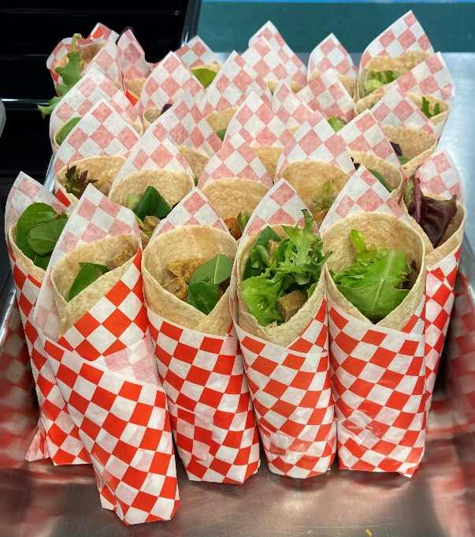
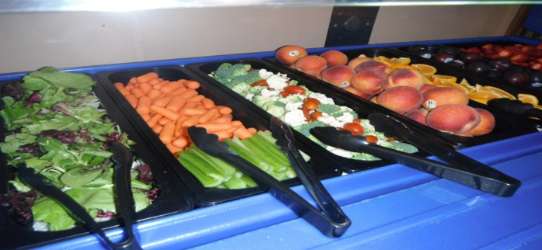
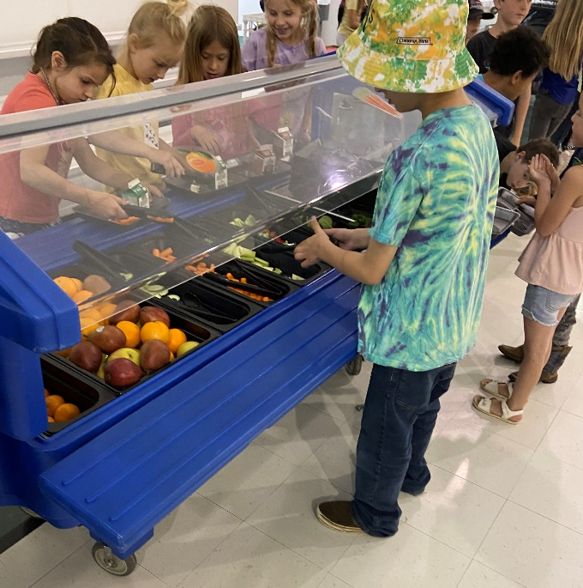
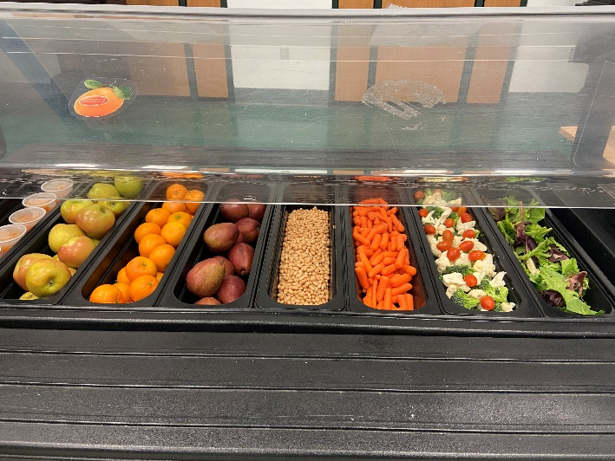
SOME HEALTHY “EYE CANDY”

Slide 7
$$$ GRANTS, grants and more grants $$$
Equipment Assistance Grants (EAG)
Kitchen Infrastructure & Training Grants (KIT)
Supply Chain Assistance Grants (SCAG)
School Nutrition Emergency Operation Cost Grants (SNEOC)
BUT WE’RE NOT DONE – Our current application is for the School Food Best Practices (SFBP) Grant. For California grown or produced, sustainably grown and whole or minimally processed foods. This grant supports local economies, environmental sustainability and animal welfare.

Slide 8
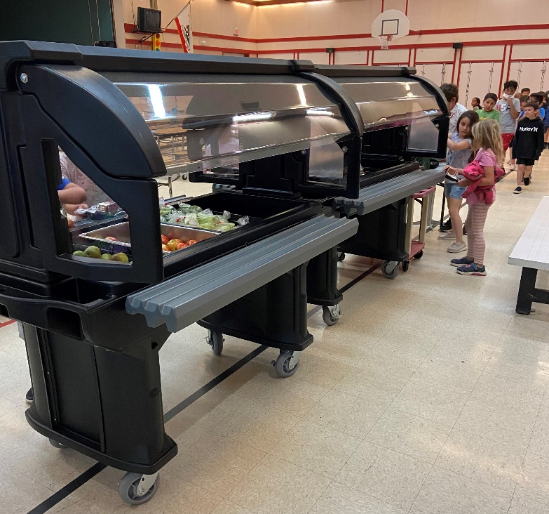
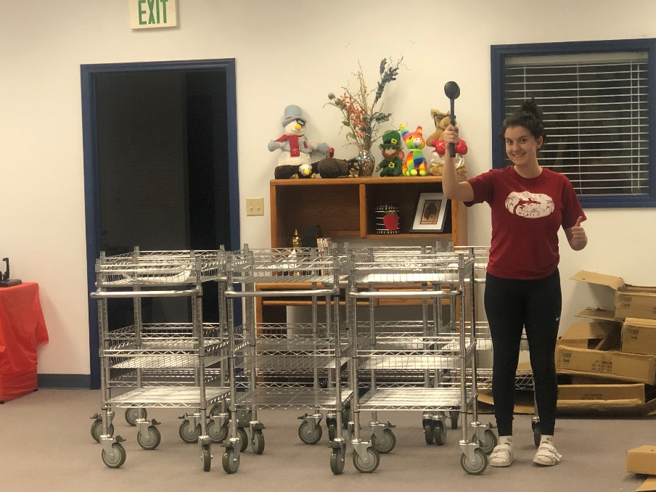
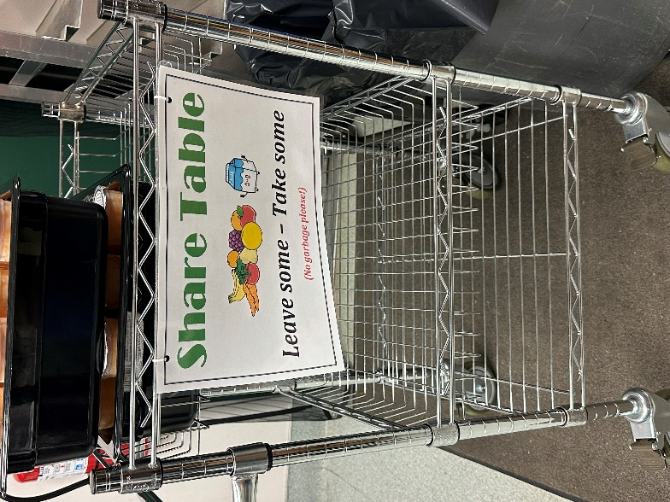
Grant purchases
*SALAD BARS *OVENS * WARMERS * SHARE TABLES, just to name a few.

Slide 9
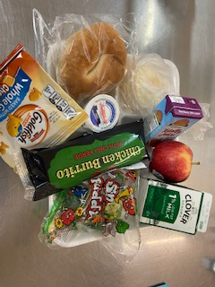
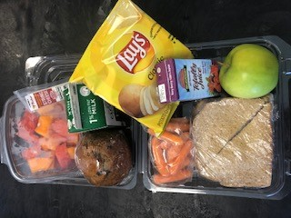
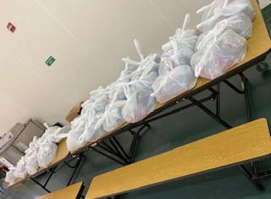
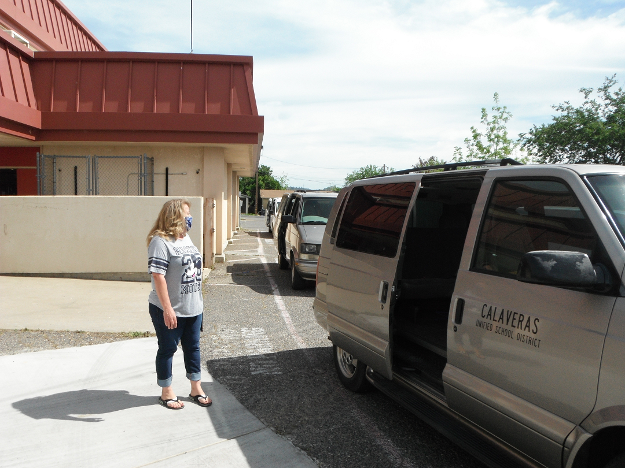
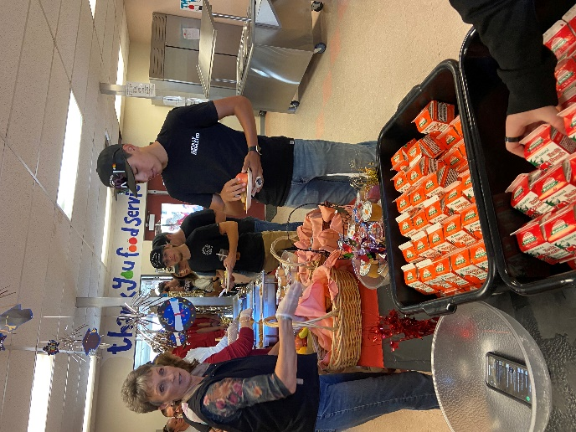
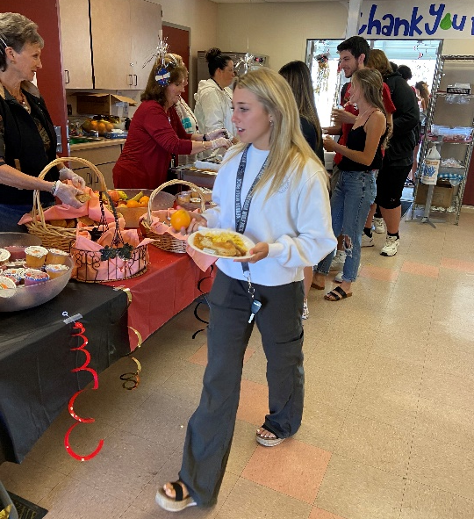
above and beyond – OUT OF THE ORDINARY
* EXTRAORDINARY SERVICE *
* COVID * ESY * FIELD TRIPS * SENIOR BREAKFAST * SPECIAL REQUESTS

Slide 10
CAN YOU SPEAK FOOD SERVICE?
While CUSD is our LEA, our FSO is the SFA. Under USDA FNS and CDE SNP we no longer operate SSO (as we did during COVID) but have transitioned back to CEP, specifically SBP, NSLP and AMS, while CDSS captures CACFP. Given the rise in ISP due to DC via CALPADS (thank you Mel) we have reapplied for CEP so that we no longer will be troubled with PLE.
Each year, PARS and PSR, though a bane, are necessary.
Yearly we divert entitlement monies to DOD and commodity items via CNIP’s.
UMP (thank you AB130), has created a rise in our MPLH, averaging 14, which CNP says is good. CACFP stipulates that only AE sites are eligible for reimbursement, however.
With KIT, EAG, SCA, SNEOC and SFBP aiding our efforts – we have done extremely well this school year. Yay FS!!!

Slide 11


RULES AND REGULATIONS
We accomplish all this while complying with the insurmountable plethora of rules and regulations imposed on us. At times this is like trying to hit a moving target.
Out of Compliance? = loss of $$$$$ No Bueno!
USDA and CDE guidelines, rules, regulations, and program applications is a presentation all by itself. Not enough time at a Board meeting.
Plus, no one wants a bored Board!

Slide 12

LOOKING TO THE FUTURE
Baby Madi says, “I can’t wait to start school to get school breakfast and lunch everyday!”

Slide 13

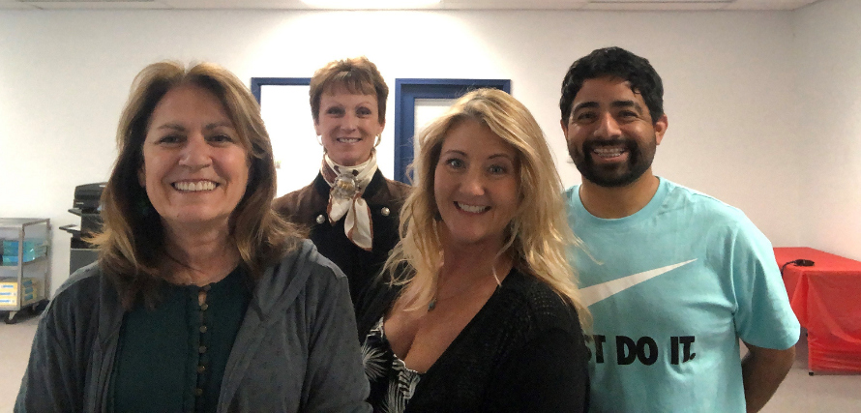
Questions?
JUDY, TRISH & MELANIE

